Slide 1
SUBJECT | LIFE SKILLS
GRADE | 3 YEAR 2
TERM | 1

Slide 2
GUIDE
WEEK 1-2 | ME AND MY TIMELINE
WEEK 3-4 | ME MY RIGHTS AND RESPONSIBILITIES
WEEK 5-6 | MY FEELINGS AND EMOTIONS
WEEK 7-8 | CHANGES IN ME

Slide 3
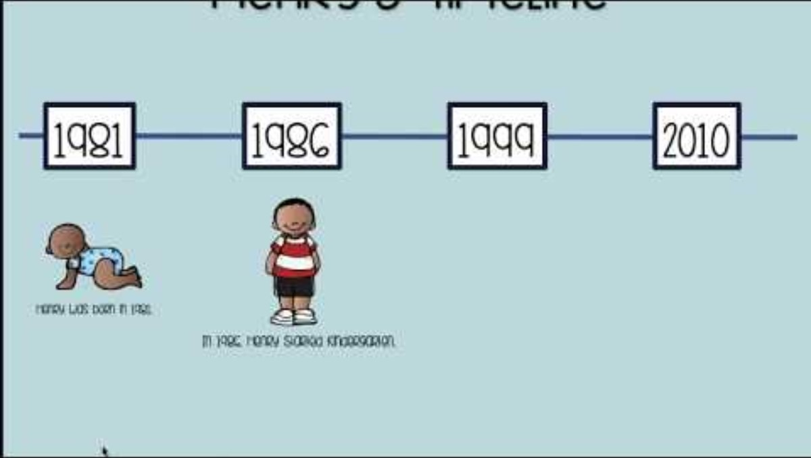
ME AND MY TIMELINE

Slide 4
Group 1

Slide 5
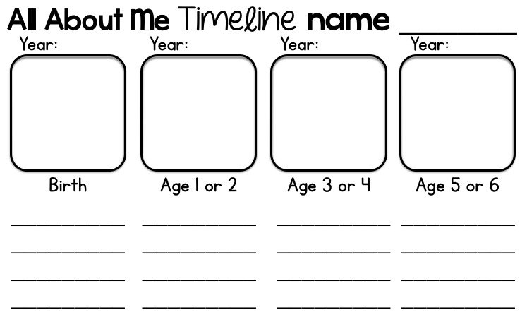

Slide 6
Group 2

Slide 7
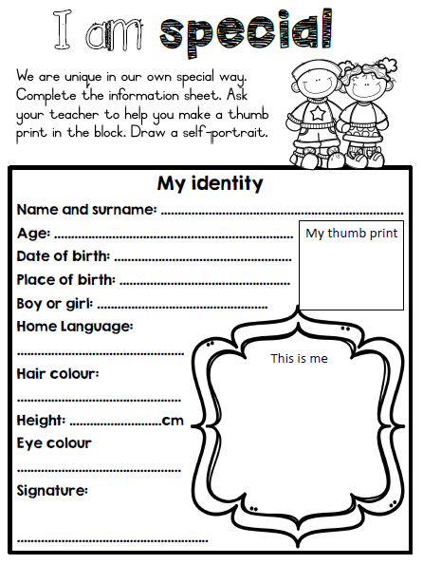

Slide 8
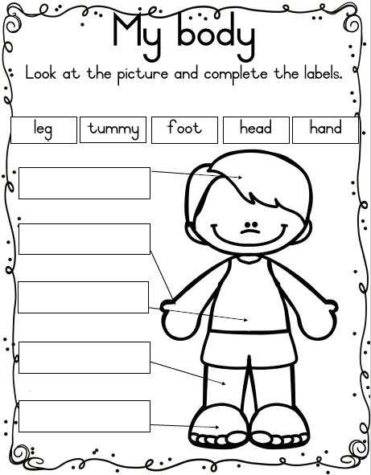

Slide 9
Group 3

Slide 10
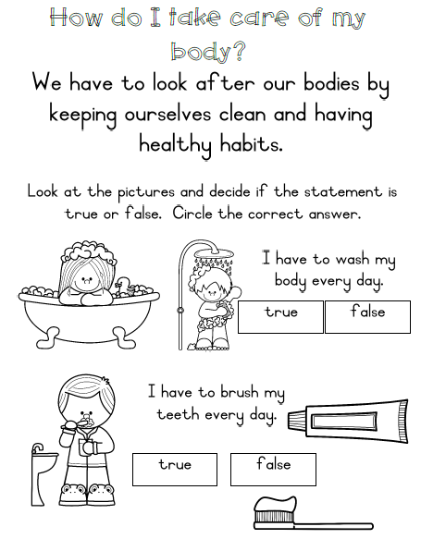

Slide 11
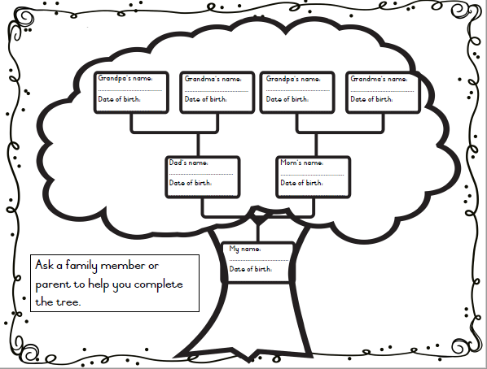

Slide 12
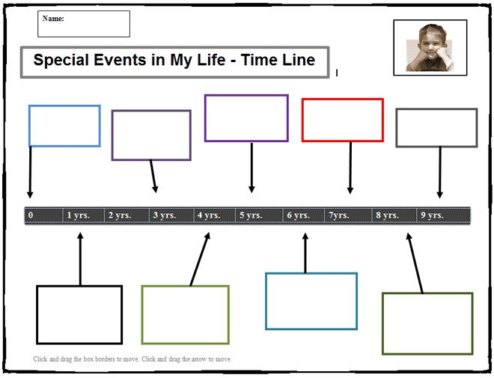

Slide 13


Slide 14
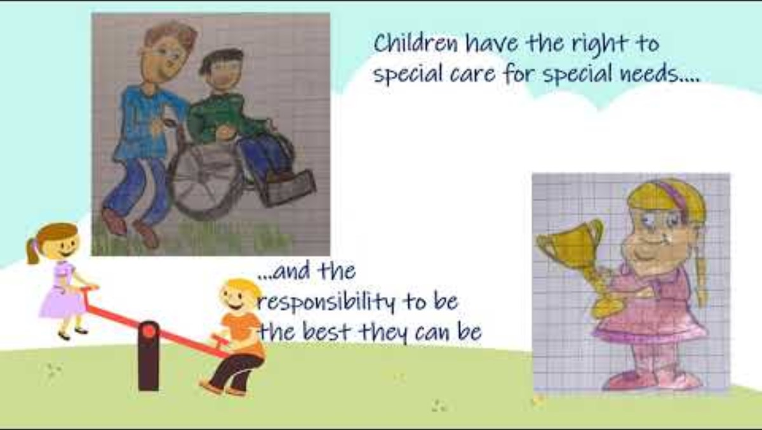

Slide 15
Group 1

Slide 16
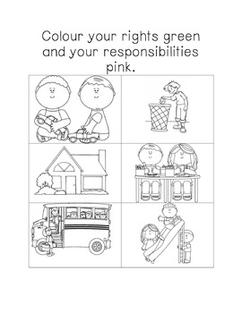

Slide 17
Group 2

Slide 18
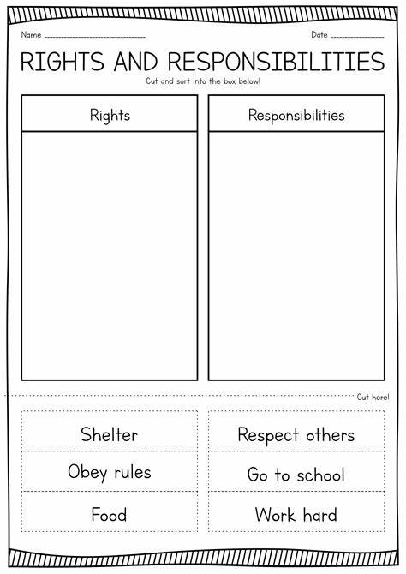

Slide 19
Group 3

Slide 20
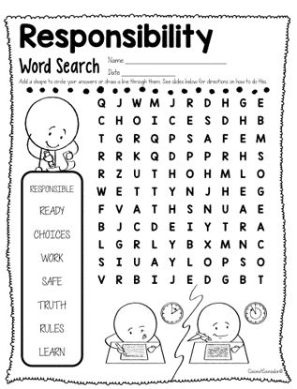

Slide 21
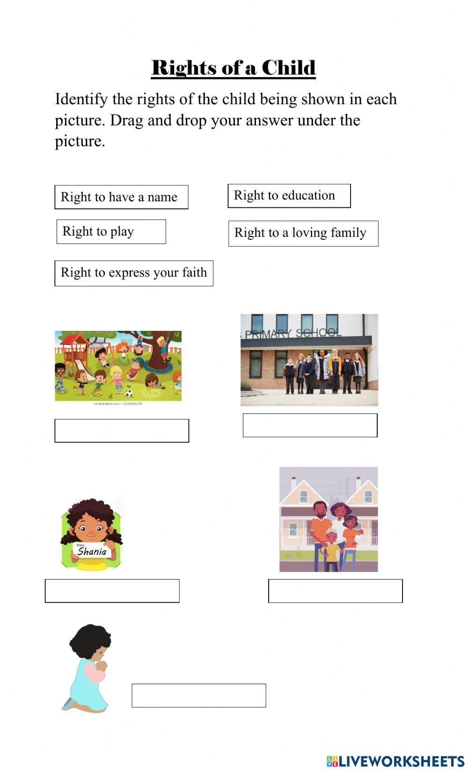

Slide 22

My feelings and emotions

Slide 23
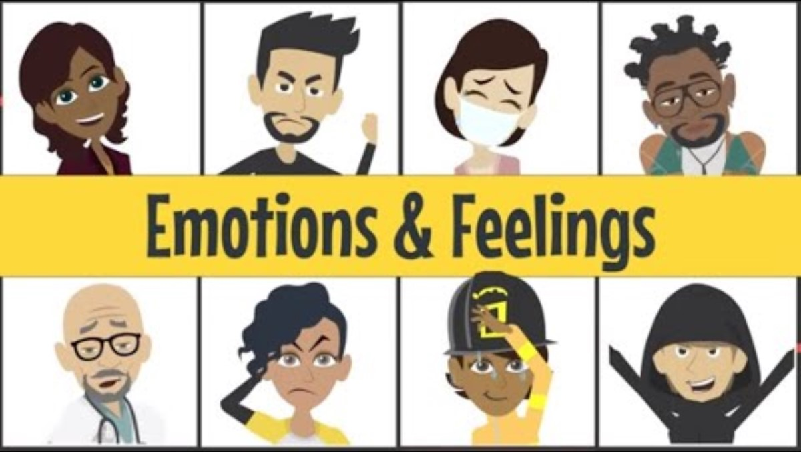

Slide 24
Group 1

Slide 25
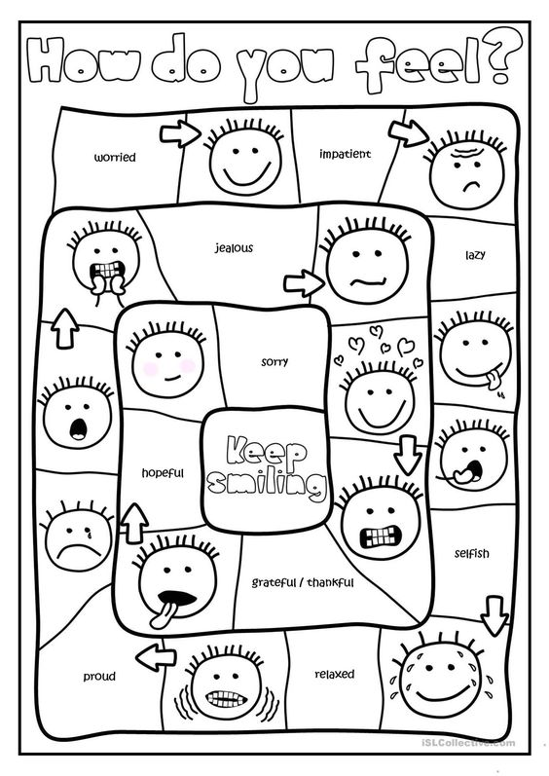

Slide 26
Group 2

Slide 27
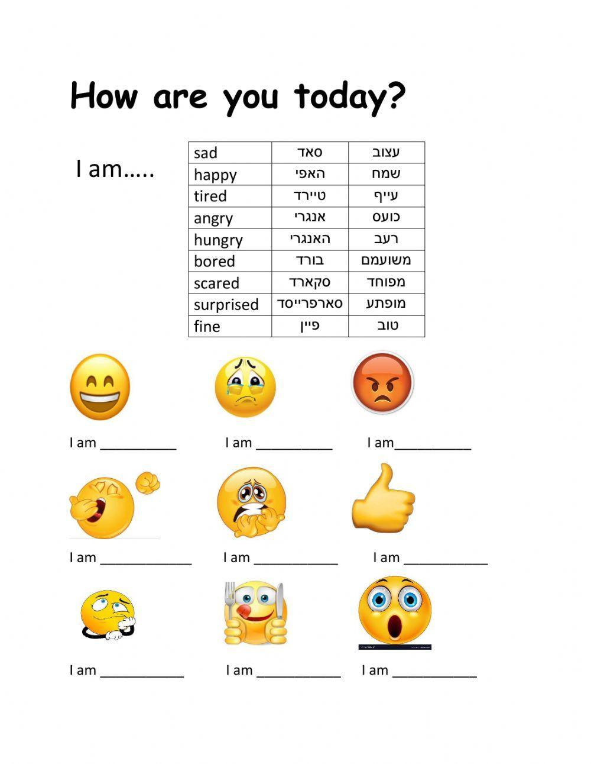

Slide 28
Group 3

Slide 29
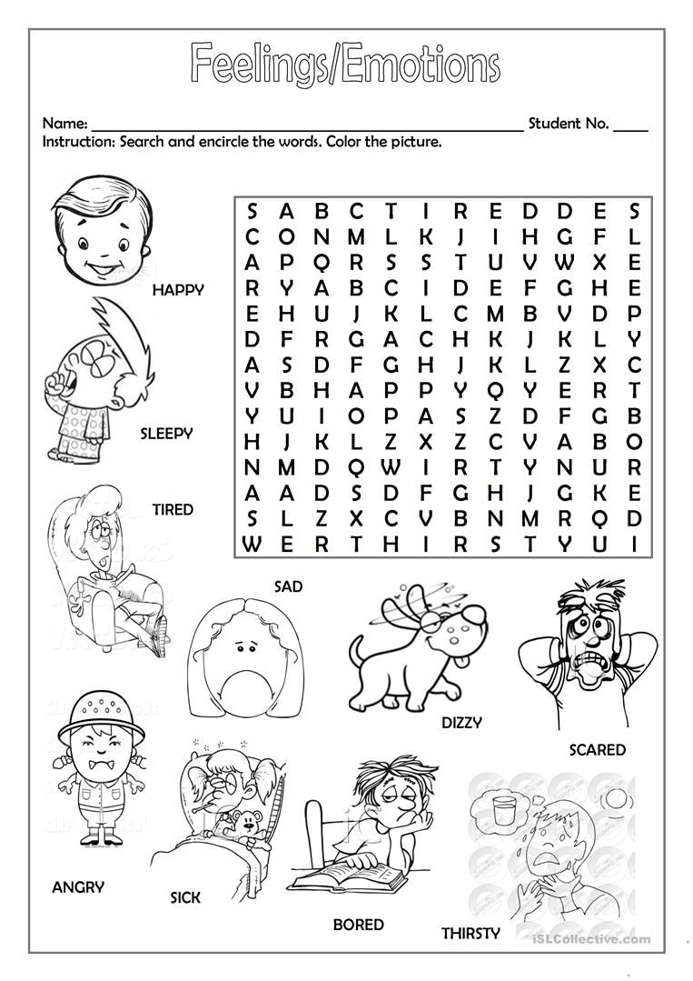

Slide 30
CHANGES IN ME

Slide 31


Slide 32
Group 1

Slide 33
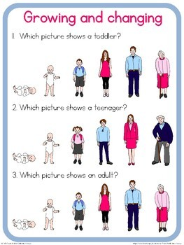

Slide 34
Group 2

Slide 35
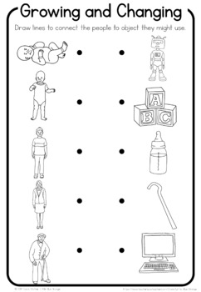

Slide 36
Group 3

Slide 37
